Slide 1
Financial sentiment analysis based on tweets
Link: Project.-Tweets-Sentimental-analyse/Project_tweets_senti_analyse(1).ipynb at main · Nastya224/Project.-Tweets-Sentimental-analyse (github.com)
Irina Zandakova
Anastasiya Golunova

Slide 2

Main idea
Sentiment analysis is a very common task in NLP that aims to assign a "feeling" or an "emotion" to text. Typically, it predicts whether the sentiment is positive, negative or neutral.
It's promising in the financial domain as changes in sentiment around a company could help predict a rise or fall in that company's stock.
In our project we check if it’s possible to predict the rise or fall of stock prices using sentimental analysis of tweets

Slide 3
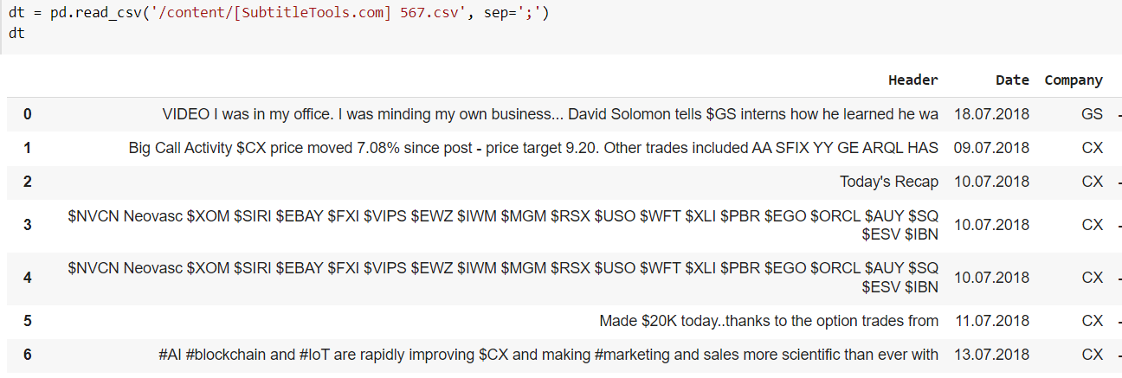
The data we use
For this experiment, we use the “Financial tweets” from Kaggle.
This file contains 28k+ tweets about publicly traded companies (and a few cryptocurrencies) that are tagged with the company they are tweeting about and their symbol as well as more fields.
For our project we have chosen 10 companies: Accenture plc, Apple Inc., Bed Bath & Beyond Inc., CEMEX, Electronic Arts Inc., Kellogg Company, M&T Bank Corporation, Micron Technology, Starbucks Corporation, The Goldman Sachs.

Slide 4
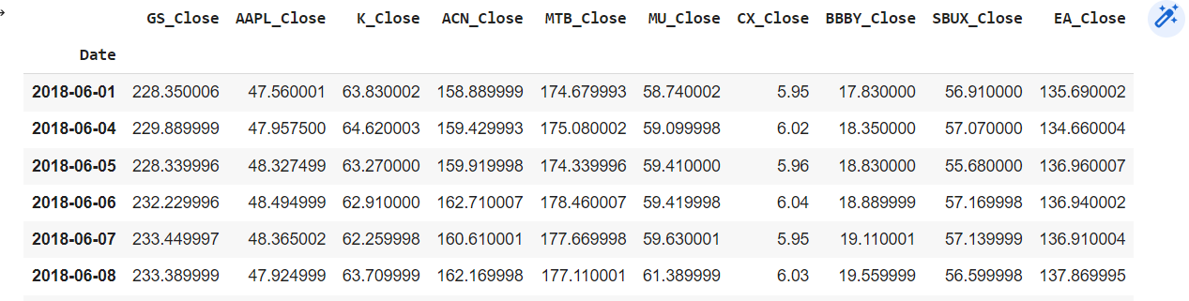
Data
We also have collected Stock Close prices for our 10 companies from Yahoo Finance. Then we converted them into daily stock returns to compare this data with the result of the model.
We used the modules: yfinance, yahoofinancials.

Slide 5
Model
FinBERT is a pre-trained NLP model based on BERT, Google’s revolutionary transformer model. FinBERT is a version of BERT trained on financial data, specifically for sentiment analysis.
The data used to train a BERT model is text from financial news services, as well as the FiQA dataset.
We took the fine-tuned FinBERT model and put it to the test on our dataset. Pretrained model "ProsusAI/finbert"
The model returns probability of tonal coloring of the tweet (Positive, Negative, Neutral)

Slide 6
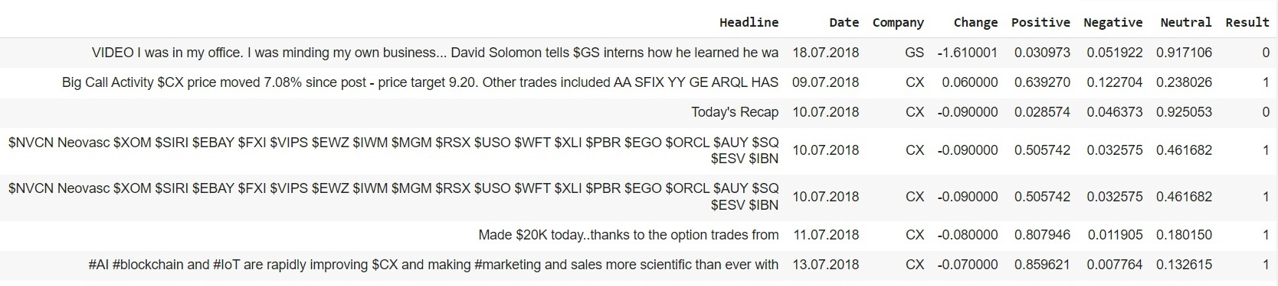
Results
Columns: headline – tweet’s text
Date – tweet publication date
Company – company’s symbol at stock
Positive (1), Negative(-1), Neutral (0)–probability of tonal coloring of the tweet
Result – indicator showing the prediction of model (1 – tweets more Positive, so stock price should increase, -1 –decrease, 0 – without changes).

Slide 7
Results
We compared the probabilities we get from the model with data about stock changes.
We grouped all tweets by company and date, then for each company we summed up all values from column ‘Results’ for tweets that were published at the same date. Then if that number was more than 0 and if stock return was more than 2%, we accepted that case as a good prediction. If that number was less than 0 and if stock return was negative and if the decline was less than 2%, we also accepted that case as a good one. And if that number was 0 and stock changes that day was less than 2%, we also took that case as good prediction.
All other cases were marked as failed predictions.

Slide 8
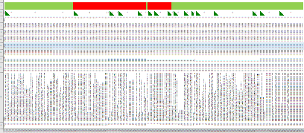
Results
This is a colored table showing which tweets were recognized correctly. Red color – models result doesn’t match the reality, green – match.
The tone coloring of 136 Tweets is correlated with stock close prices

Slide 9

Thank you for your attention

